Slide 1
Constitutional Convention & The Great Compromise

Slide 2
Articles of Confederation were weak!
Constitutional Convention held May 1787.
  Purpose: review the Articles of Confederation.
George Washington was elected President of Constitutional Convention.
Federalists wanted a strong central government.
Anti-Federalists, like Patrick Henry, opposed a strong central government.

Slide 3
Virginia Plan
states with large populations should have the most power. The larger the population, the better representation in government!
  More representation = More POWER

Slide 4
New Jersey Plan
Each state should have EQUAL representation, in ONE house.
One State, One Vote, one voice

Slide 5
Women, African-Americans, & Native Americans were NOT recognized as citizens!
And, therefore, not considered.

Slide 6
THE GREAT COMPROMISE!
Proposed by Roger Sherman from Connecticut.
Create a TWO House Legislature:
  House of Representatives - based on population
  Senate - EQUAL representation for all states.

Slide 7
3/5ths Compromise – Slaves?
Dividing question between North & South
  South – Want to count their slaves
  North – Rejects this idea because slaves are not citizens
  Compromise: 3/5^{ths} of the slave population will count towards population and therefore representation.
Notes:
The three-fifths figure was the outgrowth of a debate that had taken place within the Continental Congress in 1783. The Articles of Confederation had apportioned taxes not according to population but according to land values. The states consistently undervalued their land in order to reduce their tax burden. To rectify this situation, a special committee recommended apportioning taxes by population. The Continental Congress debated the ratio of slaves to free persons at great length. Northerners favored a 4-to-3 ratio, while southerners favored a 2-to-1 or 4-to-1 ratio. Finally, James Madison suggested a compromise: a 5-to-3 ratio. All but two states--New Hampshire and Rhode Island--approved this recommendation. But because the Articles of Confederation required unanimous agreement, the proposal was defeated. When the Constitutional Convention met in 1787, it adopted Madison's earlier suggestion.
Over the long term, the Three-Fifths Compromise did not work as the South anticipated. Since the northern states grew more rapidly than the South, by 1820, southern representation in the House had fallen to 42 percent. Nevertheless, from Jefferson's election as President in 1800 to the 1850s, the three-fifths rule would help to elect slaveholding Presidents. Southern political power increasingly depended on the Senate, the President, and the admission of new slaveholding states.

Slide 8
EXAMPLE:
South Carolina:
  400,000 people are FREE
  100,000 people are SLAVES
  100,000 x 60% (3/5) = 60,000
  Total Population = 460,000!

Slide 9
The slave trade would end in 20 years.
  Southern states believed that they needed slavery to support their economy.
There is NO mention of slavery in the Constitution

Slide 10
Key Terms:
Popular Sovereignty – political authority belongs to the people.
Federalism –sharing of power between the federal government and the states.

Slide 11
Branches of Government
Legislative Branch – (Congress) – Makes the laws.
Executive Branch – (President) – Enforces the laws.
Judicial Branch – (Federal Courts) – Interprets the laws.

Slide 12
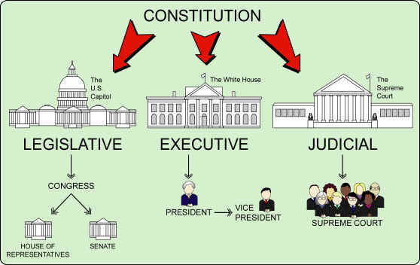
The Branches of Government

Slide 13
Draft of the Constitution completed September, 1787.
Only 3 of the 42 delegates refused to sign the Constitution.
Not a perfect document, but protected the ideas of republicanism.
James Madison is considered the father of the Constitution because he was its main author.

Slide 14
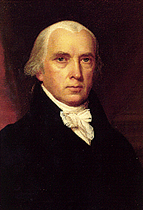
JAMES MADISON

